Slide 1
Roughness measurement using smartphone application
Pranav yogesh baradkar

Slide 2
Background
Pavement roughness
It is expression of irregularities in the pavement which causes adverse effect on ride quality.
It also affects fuel cost, tire and maintenance.
Roughness is characterised by the international roughness index which is often find using inertial profiler.
For the maintenance of the road organizations use pavement management system and for it IRI, PCI and RUT are required inputs.

Slide 3
Literature review
International roughness index (IRI)
The IRI was established in 1986 by the World Bank.
The most modern devices to find IRI is using inertial profiler.
Inertial profilers are equipped with sensitive accelerometers, a height measuring laser, and a distance-measuring instrument for measuring vehicle vertical acceleration data and the pavement profile.
Measured profiles are processed through quarter car simulation to generate the IRI.
one study reported that pavement profile data collection and analysis involve agency costs in the range of $2.23 to $10.00 per mile with an average cost of $6.12 per mile.
So, it is required to find cost efficient way to measure IRI with considerable accuracy.

Slide 4
Literature review
Use of smartphone
Modern smartphones are equipped with many useful sensors.
gyroscopes, magnetometers, GPS receivers, and 3D accelerometer are already mounted in smartphones for mapping the orientation of the smartphones screen and other activities.
3D accelerometer measures variation of velocities in the three dimensions x-, y- and z-.
GPS provides the acceleration data at particular location.
There are many application such as Androsensor, Roadroid etc available to measure the acceleration data in three dimensions.

Slide 5
Literature review
Using PROval software (s.Islam)
Smartphone mounted on car dashboard.
Acceleration and profile data is taken using inertial profiler and using PROval software IRI had been found for the reference.
Route is divided into 3 sets and 5 runs have been taken on each set to check the IRI consistency with the number of runs.
Acceleration data found out using mobile application gone through inhouse program for the double integration which provided pavement profile.
Measured profile put it into the PROval software to find out IRI.
Smartphone based IRI and inertial profiler IRI have been compared and found out accuracy of the smartphone IRI.
However, for the rougher pavement smartphone IRI value have been calibrated using linear regression.
In this method performance of different smartphones at different position with different car has not been taken into consideration.
Vibrations due to car suspensions had not been normalize.

Slide 6
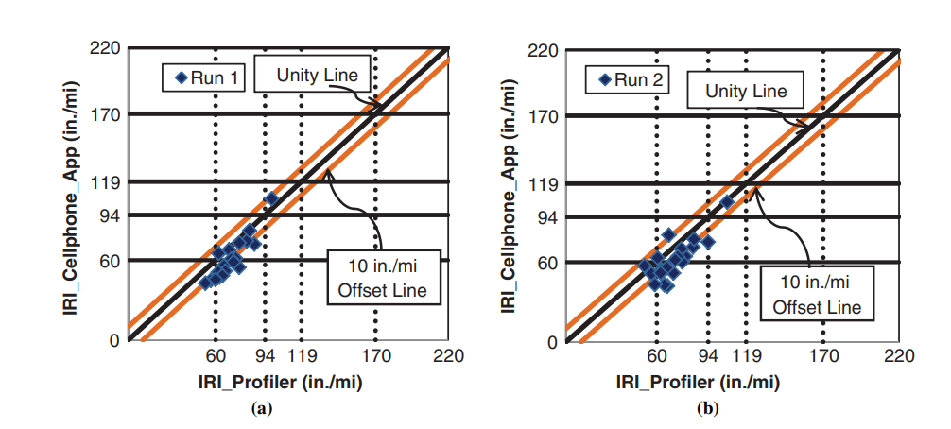
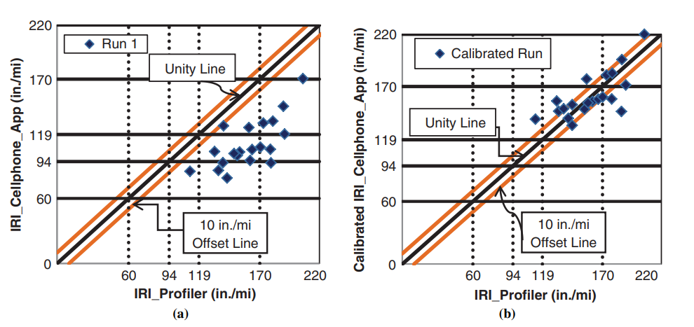
IRI smartphone vs IRI profiler .
IRI is calibrated for the rougher pavement.

Slide 7
Literature review
Using pattern matching and variance. (waleed)
Two smartphones mounted on car dashboard and car drove at the speed of 80kmph and 4 kmph to get acceleration data.
Acceleration and profile data is taken using South Dakota profiler and profile data analyzed using quarter car simulation to generate reference IRI.
Route is divided into 20 segments for data collection.
Smartphone acceleration data gone through MATLAB program for applying median and moving average filters.
Filtered signals are analyzed using pattern matching methods like cross correlation and welch paridrome to check different IRI signal shows any different pattern or not. In the analysis all the IRI signal has same pattern and shown more damping at 20Hz may be because of car suspension (not studied under the scope).
Magnitude of variance for each segment is taken as the variable for finding IRI and linear relationship developed using linear regression with R^2 = 0.85 which shows good accuracy
However, another Sony smartphone shows deviation in the results may be because of lower accuracy of sensors.
Vibrations due to car suspensions had not been normalize.

Slide 8
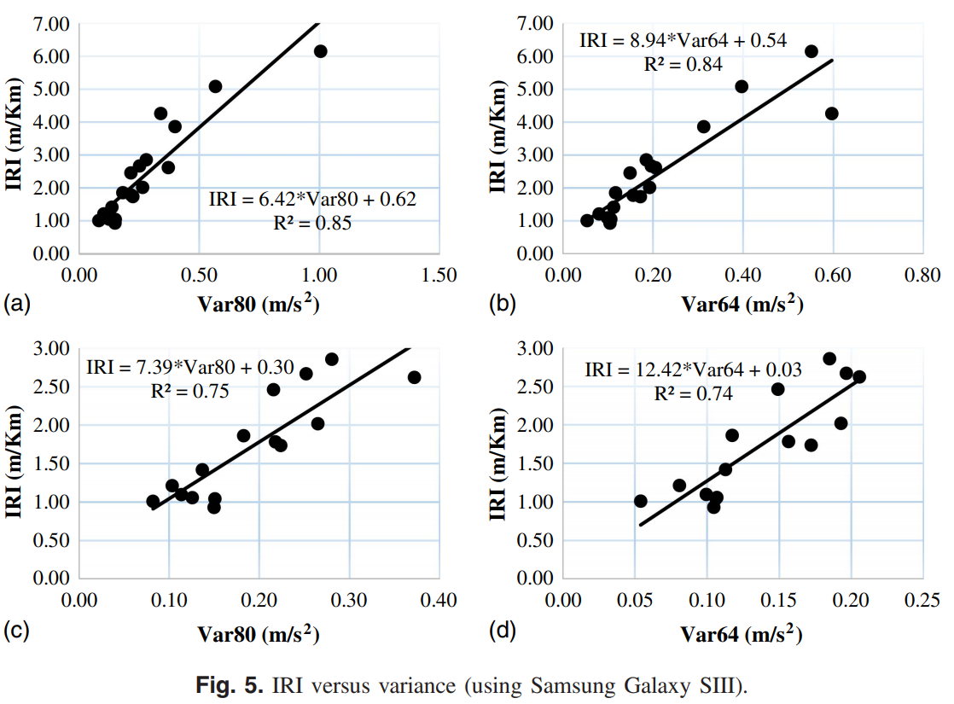
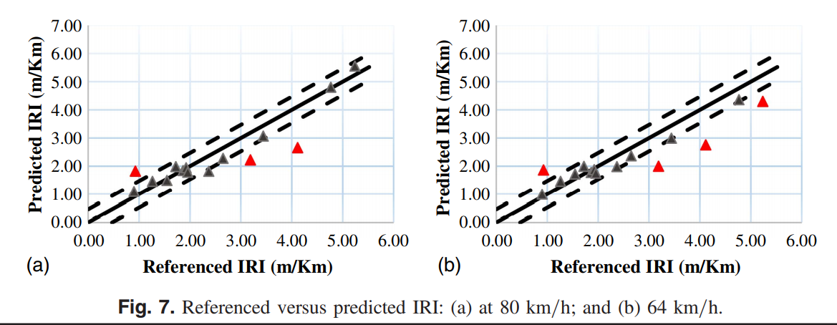
Literature review
Using pattern matching and variance.
For the validation of the data 15 segments of the routes are chosen in which 5 have more roughness.
IRI is calculated using linear equation.
Smartphone IRI and reference IRI compared which shows good accuracy with very less data points outside offset.

Slide 9
Literature review
Consistency of smartphone IRI (Hossain)
Two smartphones mounted on car dashboard to check the consistency of the IRI data.
Roadroid application is used to collect the IRI of the pavement.
Also analyzed consistency of IRI with PCI value which shows improper relationships.
Comparison of the IRI using Samsung and Motorola shows good consistency with the R^2 = 0.8.
Which shows once we develop a good application to find IRI then it will be independent of smartphone type.

Slide 10
Research gap
As previous research did not consider the effect of orientation and location of the smartphone on the IRI.
Double integration technique was needed to calibrate for the rougher pavement and had not check it’s consistency using different smartphones so we can try finding IRI using this technique and check how it is changing it’s results.
Filtering of signals not been performed in double integration method. We can try finding IRI after filtering signal which can remove vibration due to suspension.
Variance method gave good results and it is easy to perform data analysis so that we directly make an application which find IRI using variance. But it shows inconsistency with the second smartphone and did not find out reason for damping at 20Hz. We can check this method for different smartphones at different orientation and location.
Apart from linear regression we can use other ML models to find the IRI.
There is no study who justified the consistency of IRI measuring application on different orientation and location of placing.

Slide 11
Questions
Where should the smartphone be placed inside car for recording IRI?
Ans: Currently there is no study who have demonstrated relationship of place of smartphone and accuracy of the results. In my research this will be one of the main motive to finalize place of the smartphone with viable data results. \
How to measure IRI of a given pavement?
Ans: There are two methods use fast Fourier transform and find the profile of the road and from it calculate the IRI using quarter car model. Second is to use in house integration to find profile data and then use quarter car model to calculate IRI. Third method is use variance of acceleration of each segment and build relationship between IRI and variance using different ML models.
Another method we can try is relationship between acceleration standard deviation from the mean of each segment with IRI and then validate the model using ML techniques.

Slide 12
Questions
Does the smartphone app gives same result on different phones?
Ans: Recent study has proved the consistency of the data from two smartphones for particular application but in 2018 study they got very inconsistent data from two smartphones and they had not mention clear reason behind it. So It will be require to check the results with different smartphones and also with different application.
What is the effect of tyre pressure?
Ans: I have not found any study who has mentioned effect of tyre pressure and suspension on the IRI.

Slide 13
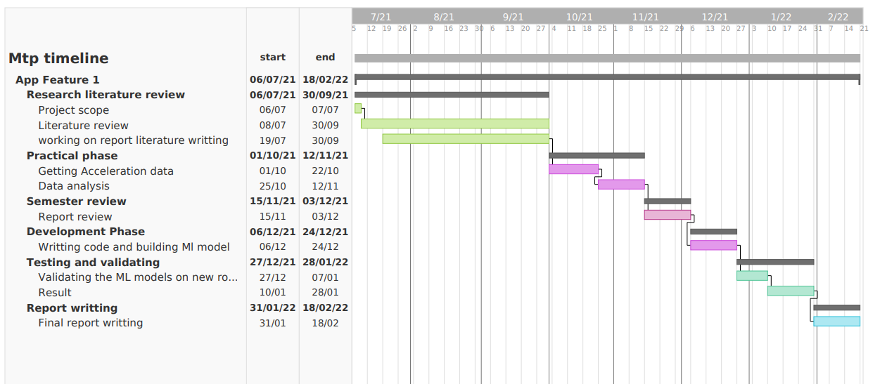
Timeline

Slide 14
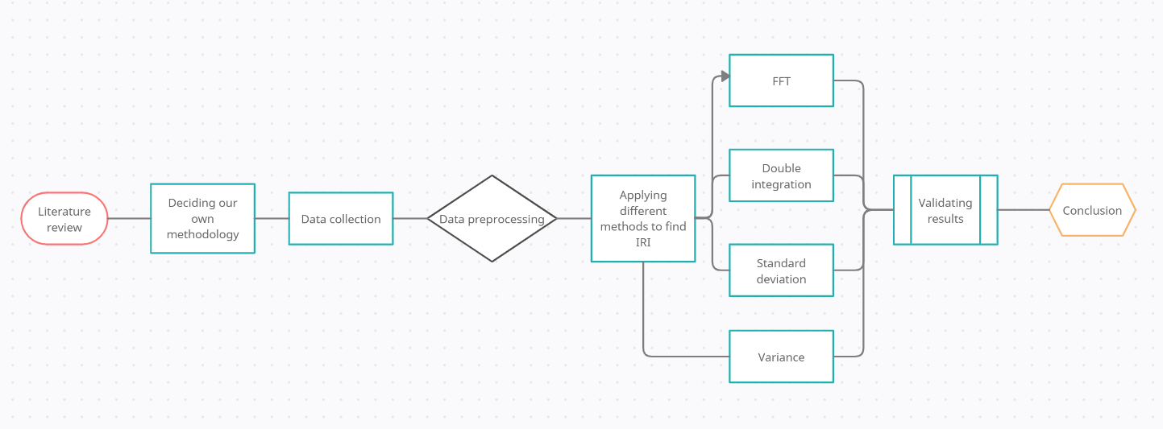
Methodology

Slide 15
Road profile using accelerometer
This paper motive was to estimate road profile using accelerometer data for vehicle dynamics.
Here, They have used inverse calculation to calculate road profile.
They put the phone at dashboard and also at wheel to calculate acceleration off vehicle frame and suspension.
Calculated un-mass and mass parameter of quarter car vehicle model.
From the mathematical model of quarter car they simulated it in the MATLAB and formed road profile.
Basically, they were trying to build low cost inertial profiler.

Slide 16
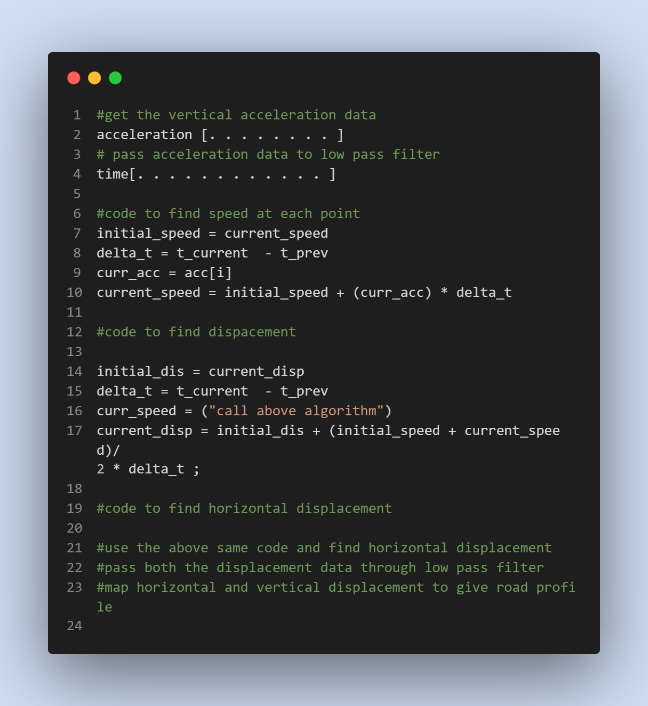
Double integration pseudo code
Apart from above algorithm some paper shows Kalman filter can give better results.
Drawback of double integration I got some papers is, it amplify some signals and it may transform negative displacement into positive. So filtering will be very important criteria.
Code for finding IRI is under progress.

Slide 17
Profile of airport pavement

Slide 18
IRI Measurement methods (IRI manual)
Class 1: Precision profiles
Represent highest accuracy for measurement of IRI.
Require longitudinal profile of wheel track as a measure of IRI calculation.
The distance between samples should be no greater than 250 mm and the precision in the elevation measures must be 0.5 mm for very smooth pavements.
At the present time, only rod and level and the TRRL Beam methods have been demonstrated to be valid Class 1 methods.
Drawback of this method is, It require more efforts and time consuming.

Slide 19
IRI Measurement methods (IRI manual)
Class 2: Profilometric method
This class includes all other methods in which profile is measured as the basis for direct computation of the IRI.
This results are not accurate as class 1 results.
presently includes IRI values computed from profiles measured with high-speed profilometers and with static methods that do not satisfy the precision and/or measurement interval requirement.
At the present time, the APL Trailer is the only dynamic profilometer that has been experimentally validated over the range of roughness covered in the IRRE.

Slide 20
IRI Measurement methods (IRI manual)
Class 3: IRI estimates from correlation equation
In this method data is extracted using RTRRMS method and it has been compare in scale of IRI using mathematical model.
The majority of road roughness data that is collected throughout the world today is obtained with RTRRMS.
The RTRRMS measure depends on the dynamics of a vehicle to scale the measurements to yield roughness properties comparable to the IRI.
The dynamics of a vehicle change easily, very rigorous maintenance and operating procedures must be employed for the vehicles used, and control testing must be made a routine part of normal operations.
When changes occur, there is no simple correction that can be applied; instead, the entire roadometer-vehicle system must be recalibrated.
The measures obtained can be used to estimate IRI through regression equations if a correlation experiment is performed

Slide 21
Roughometer (W. RONALD HUDSO)
The basic roughometer used at the AASHO Road Test was constructed by the Bureau of Public Roads.
The roughometer may be used to estimate two variable s—pre sent serviceability rating and slope variance —associated with roughness
Roughometer need calibration check regularly to give better readings.
One normally applied calibration procedure consists of checking a measuring device against a standard and then adjusting the device either mechanically or electrically until the output is equal to the standard by definition.
And second is several known loads are applied to the ring and the corresponding deflections are recorded. This procedure is repeated several times and the mean deflection for a given load is established.
A best fitting line is passed through the points and a calibration curve results.
From this curve it is then possible to predict an unknown load from a known deflection of the ring. In this type of calibration, an accurate loading platen, such as a Universal testing machine, is used as the standard.

Slide 22
Roughometer calibration
Some instruments, however, are used to record dynamically, and their output depends not only on the accuracy of the static calibration, but also on the method and speed with which the devices react to dynamic excitation.
he leaf springs and the integrator of the roughometer can be calibrated separately for a known input of deflection or displacement. It is impossible from this static calibration.
That’s why roughometer comes under the category of dynamic calibration.
As the roughometer was used it became more apparent that the variability in indicated roughness made it impossible to record the actual roughness history of test sections with the desired degree of accuracy. It was clear that a method of dynamic calibration had to be developed if the roughometer was to become a useful tool at the Road Test.

Slide 23
Roughometer calibration
Theoretically it is possible to calibrate the roughometer directly against the profilometer every day. This, however, would lost the purpose of using the roughometer instead of rod and level.
So, It was required to setup something quick to calibrate roughometer.
If the control charts show the roughometer to be out of control, the output must be adjusted to bring it into control. By trial and error, tire pressure, travel speed or mechanical parts can be adjusted until the roughometer reads the calibration course correctly.
Experimentation with the roughometer indicated that the variation on any one day might not be constant throughout the entire range of roughness.
four calibration sections were set up: smooth (80 to 100 in. per mi), medium 35 (100 to 160 in. per mi), medium rough (180 to 200 in. per mi) and rough (230 to 250 in. per mi).

Slide 24
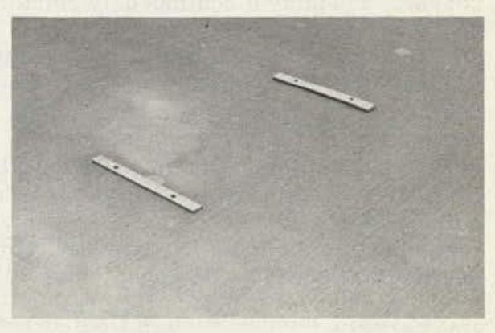
Roughometer calibration
the primary factor involved is that the course must remain constant in roughness. Secondly, the four sections should be adjacent for convenience
The pavement chosen was of Portland cement with light traffic so that roughness of the road will not change much in coming years.
To simulate roughness, a series of artificial bumps were installed which could be standardized for use elsewhere. Bars of tempered aluminum were chosen as readily available and corrosion resistant. Bars of varying width and height were used to simulate various types and severity of bumps, and the proper number of bumps required to produce the range of roughness desired was installed.

Slide 25
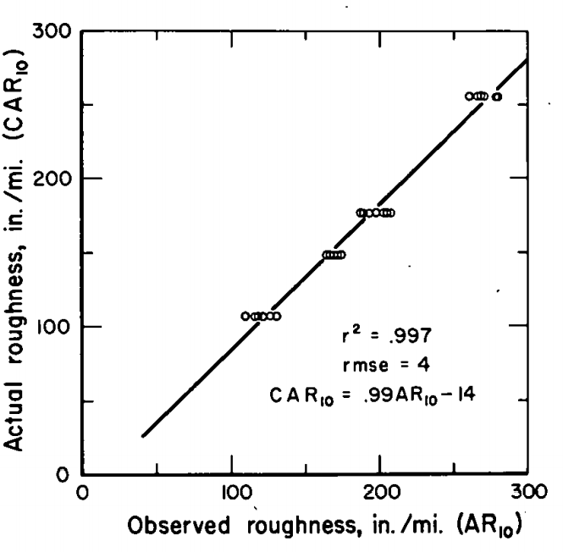
Steps in Calibration Procedure
Run the roughometer at least 1 mi to get the whole system warmed up and eliminate any flat spot developed in the tire.
Run the four calibration sections, which are laid out in random order, three times in each direction for a total of six readings on each course. (Using both directions is a convenience).
Average the six runs for each course and convert the four averages to AR10 (in. per mile).
Plot the average indicated roughness for each section against the constant roughness for that section.
The least squares regression line for these points becomes a calibration or correction factor from which the output on any test section can be corrected to the standard

Slide 26
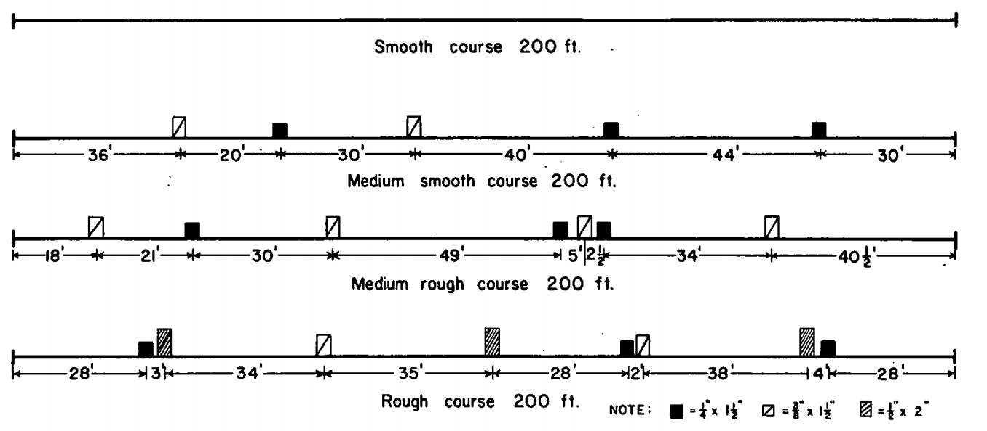
Steps in Calibration Procedure
An assumption about the calibration course is that its roughness is not changing. This can be true by definition, as in the case of a meter bar in the Bureau of Standards, or the variation in roughness can be acceptably small.
However, as long as it can be assumed that the relationship between the original corrected roughness and SV still holds, this need not be done. It will reduce our efforts of doing rod and level survey every time.

Slide 27
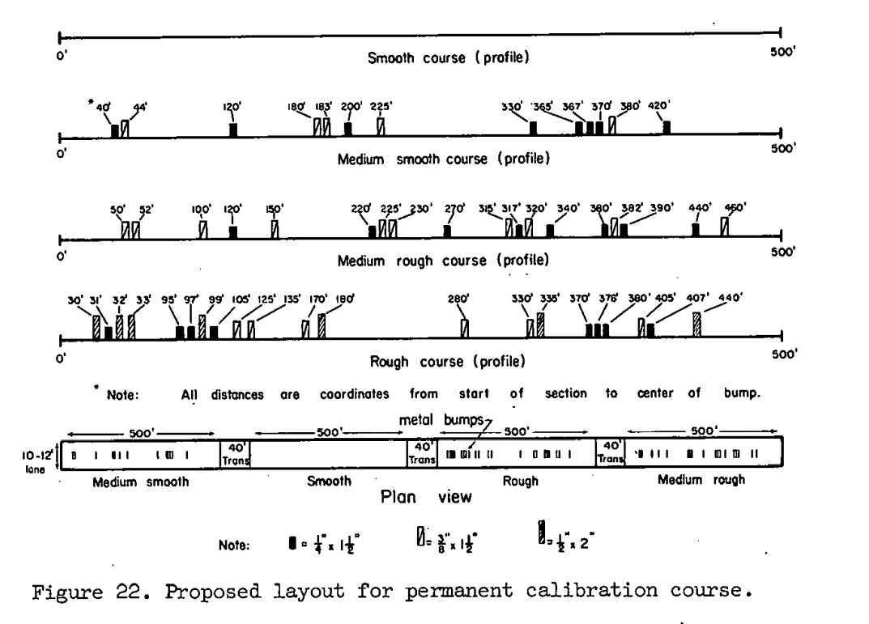
Setting up a Permanent Calibration Course
There is no previous experience to indicate exactly how to establish such a course.
Possibly a continuously reinforced concrete pavement would do the job successfully.
It would probably be helpful to locate the calibration course on a residential street, which would have some loo continuous traffic of low magnitude to 2 serve as conditioning traffic.

Slide 28
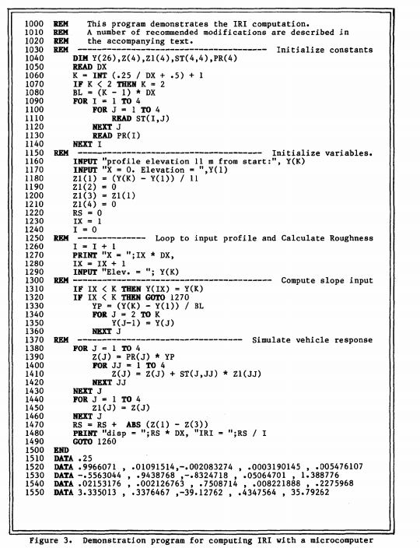
Programm to calculate IRI (IRI manual)

Slide 29
References
Shahidul Islam, William G. Buttlar, Roberto G. Aldunate, and William R. Vavrik. Measurement of Pavement Roughness Using Android-Based Smartphone Application, Transportation Research Record: Journal of the Transportation Research Board, No. 2457, Transportation Research Board of the National Academies, Washington, D.C., 2014.
Mohammad Hossain and Kerrie Schattler2. Evaluation of International Roughness Index Measurement Using Cell Phone App and Compare with Pavement Condition Index, airfield and highway 2021.
Waleed Aleadelat. Evaluation of Pavement Roughness Using an Android-Based Smartphone, American society of civil engineers 2018.

